Slide 1


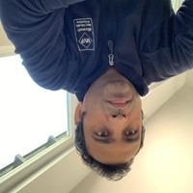


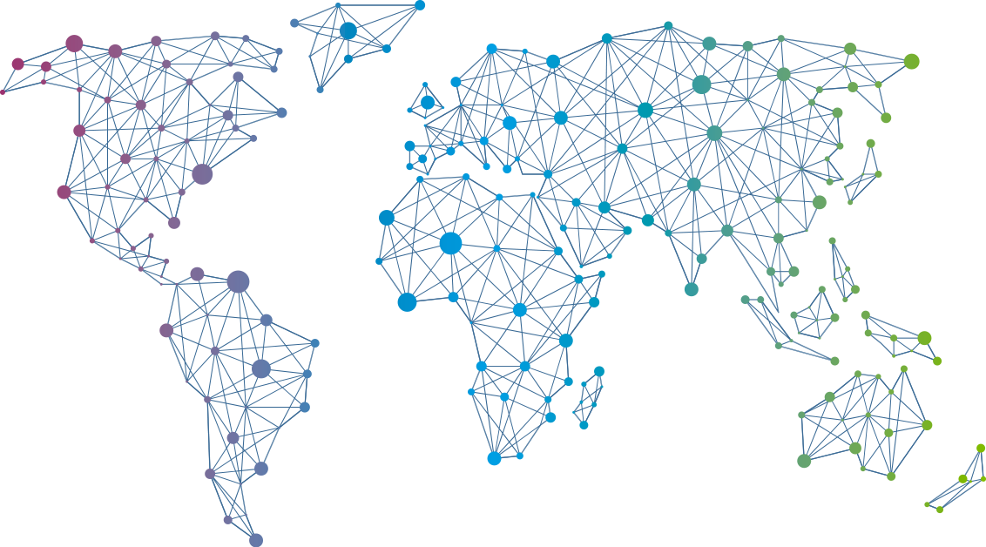

Speaker
Prabhat Nigam
PowerShell Automation: Human Building Machines
Remote Working with Azure Virtual Desktop
Prabhat Nigam
PrabhatNigamXHG
September 16th & 17th
^{Online Event}
Powered By
International Conference

